Slide 1
Monte-Carlo particle transport
Lecture 3

Slide 2
This lecture
Cross section – what it is
How we can model any particle interaction with the material using cross section and physical model
How its done in Geant4 – transportation and types of processes
Example: gamma in germanium – calculated mean free path vs simulation

Slide 3
Cross section
Let’s consider a simple example: one particle flies toward a target consisting of a single uniformly distributed element
Let’s say particle have one type of interaction with target nuclei – any general interaction – idea stays the same
Cross section σ – effective area of this interaction around the nuclei
If particle flies into it- interaction will happen
Not geometrical cross section of the nuclei. It’s characteristics of interaction probability between nuclei and particle – it can be much larger or much smaller than actual cross section of particle/nuclei
Sometimes also called microscopic cross section!
Can be defined not only for nuclei, but for elements, electrons, any particle – nuclei is just an example

Slide 4
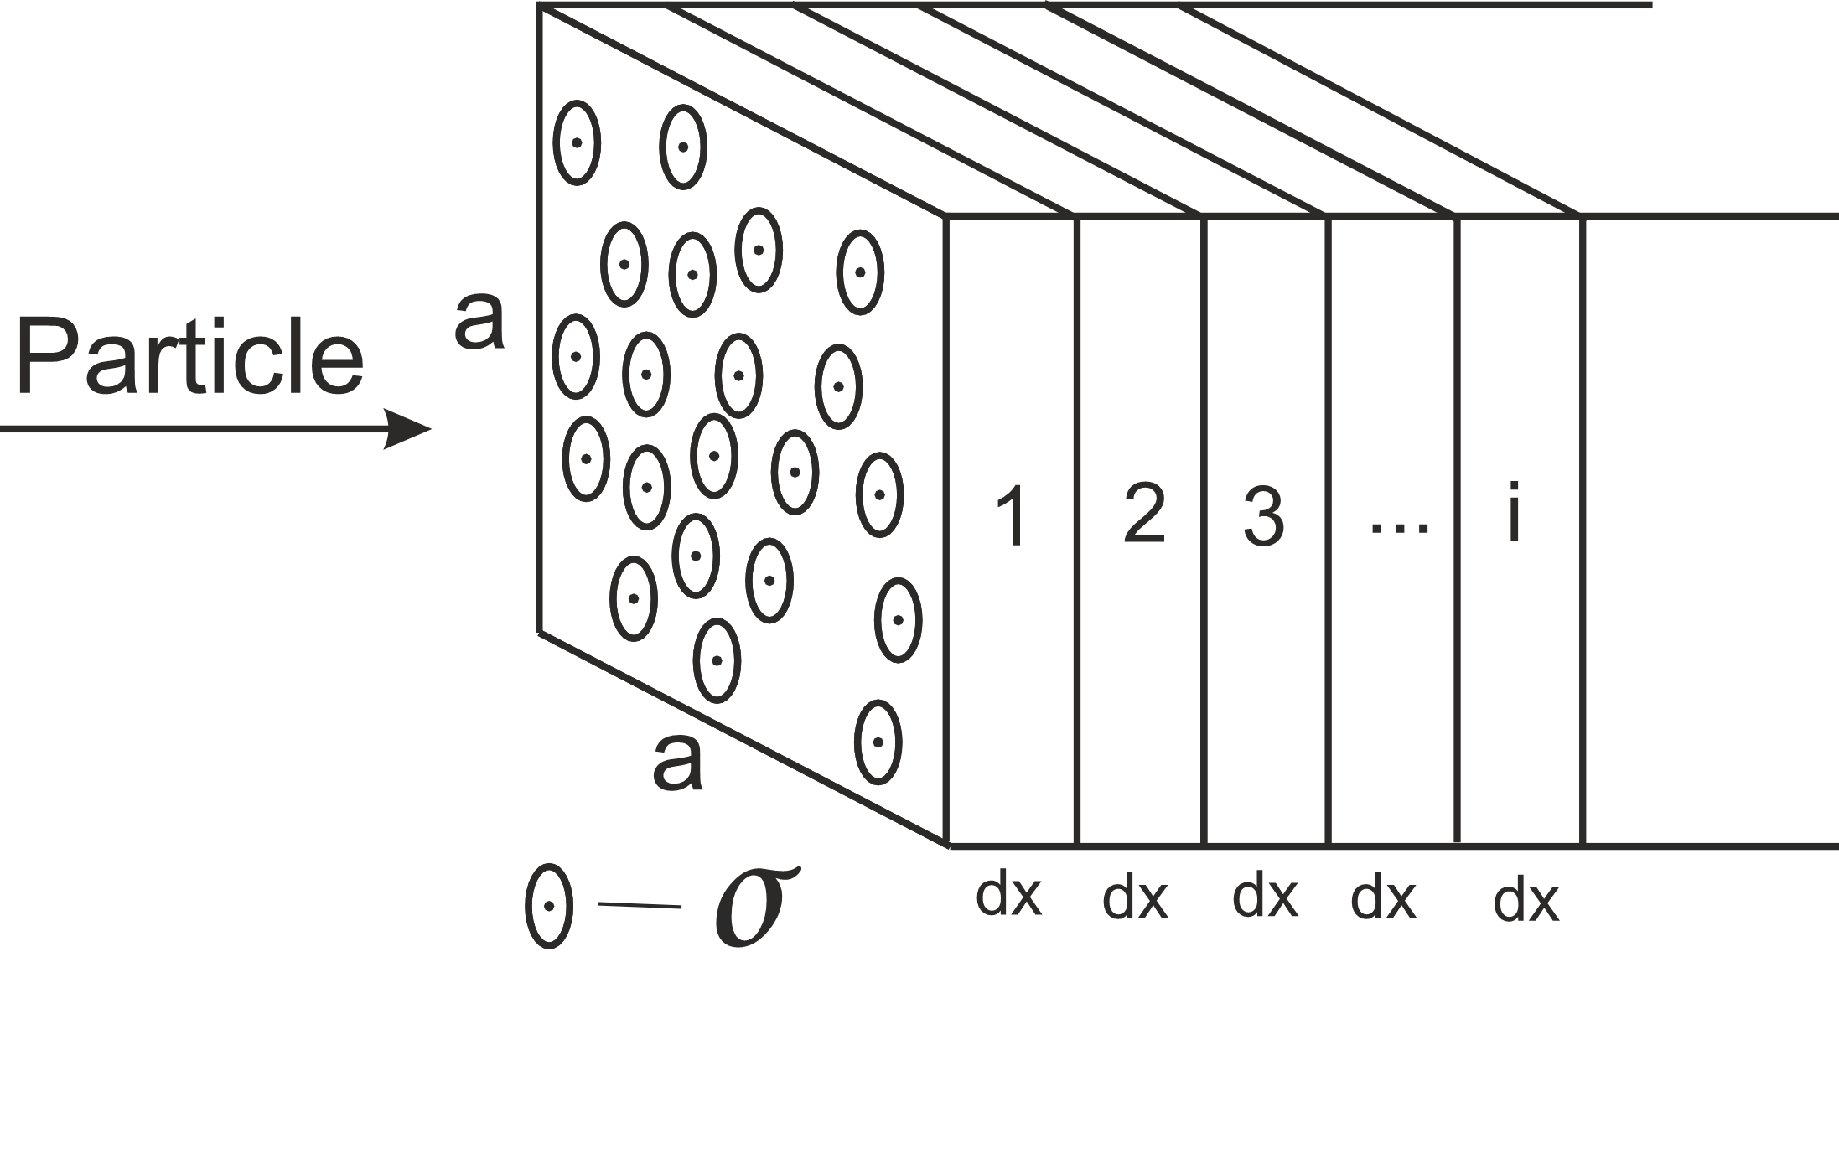
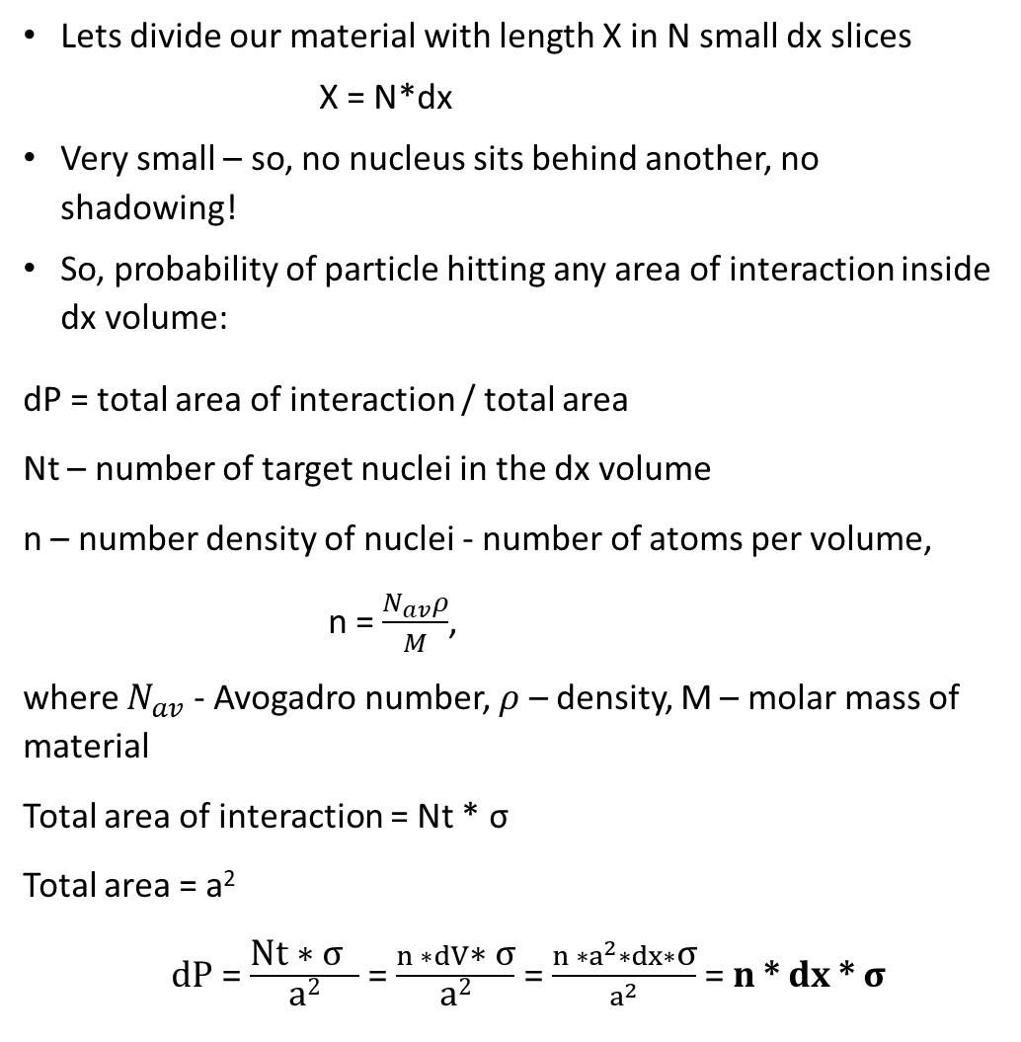
Cross section
Lets divide our material with length X in N small dx slices
X = N*dx
Very small – so, no nucleus sits behind another, no shadowing!
So, probability of particle hitting any area of interaction inside dx volume:
dP = total area of interaction / total area
Nt – number of target nuclei in the dx volume
n – number density of nuclei - number of atoms per volume,
n = $\frac{N_{av}ρ}{M}$,
where $N_{av}$ - Avogadro number, $ρ$ – density, M – molar mass of material
Total area of interaction = Nt * σ
Total area = a²
dP = $\frac{\text{Nt}\text{ ∗ }\text{σ} }{\text{a}\text{2}}$ = $\frac{n ∗dV\text{∗ }\text{σ}}{\text{a}\text{2}}$ = $\frac{n ∗a^{2}∗dx∗\text{σ}}{a^{2}}$ = n * dx * $\text{σ}$

Slide 5
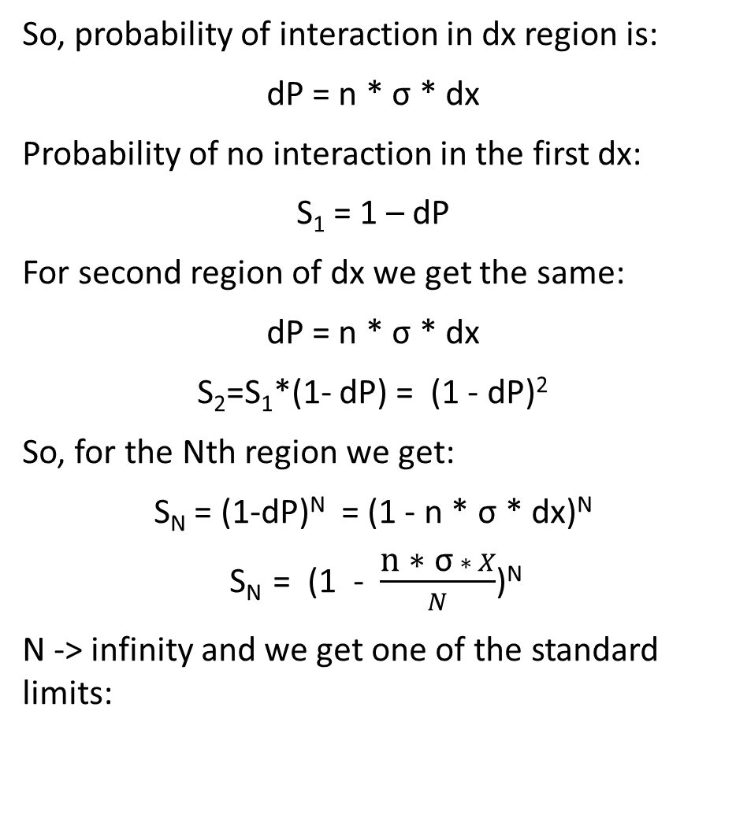
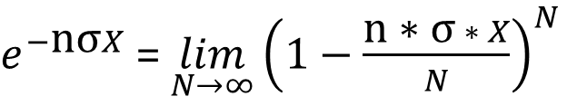
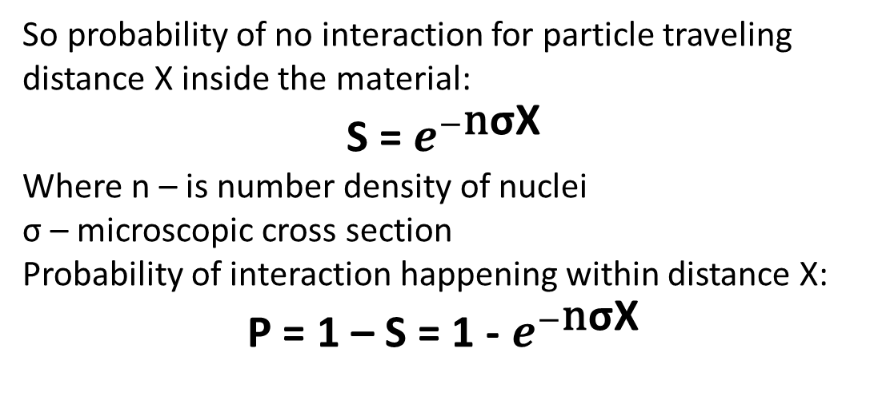
Cross section
So, probability of interaction in dx region is:
dP = n * σ * dx
Probability of no interaction in the first dx:
S₁ = 1 – dP
For second region of dx we get the same:
dP = n * σ * dx
S₂=S₁*(1- dP) = (1 - dP)²
So, for the Nth region we get:
S_{N} = (1-dP)^{N} = (1 - n * σ * dx)^{N}
S_{N} = (1 - $\frac{\text{n}\text{ ∗ }\text{σ} ∗ X}{N}$)^{N}
N -> infinity and we get one of the standard limits:
So probability of no interaction for particle traveling distance X inside the material:
S = $e^{−\text{n}\text{σ}\text{X}}$
Where n – is number density of nuclei
σ – microscopic cross section
Probability of interaction happening within distance X:
P = 1 – S = 1 - $e^{−\text{n}\text{σ}\text{X}}$
$e^{−\text{n}\text{σ}X}$ = $\lim_{N→∞}{{\left(1−\frac{\text{n}\text{ ∗ }\text{σ} ∗ X}{N}\right)}^{N}}$

Slide 6
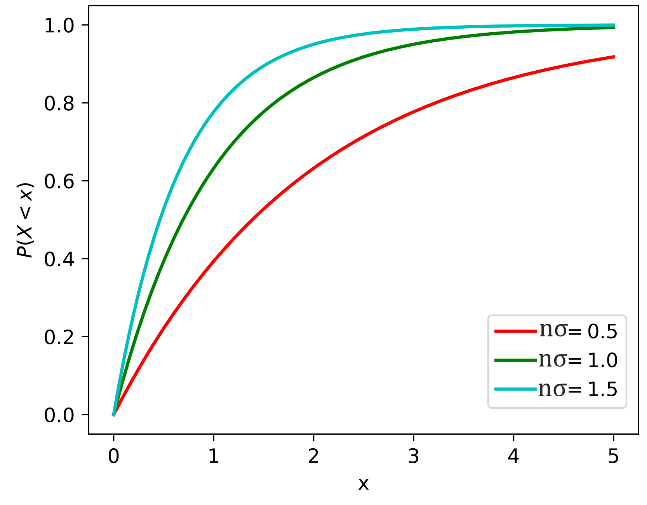
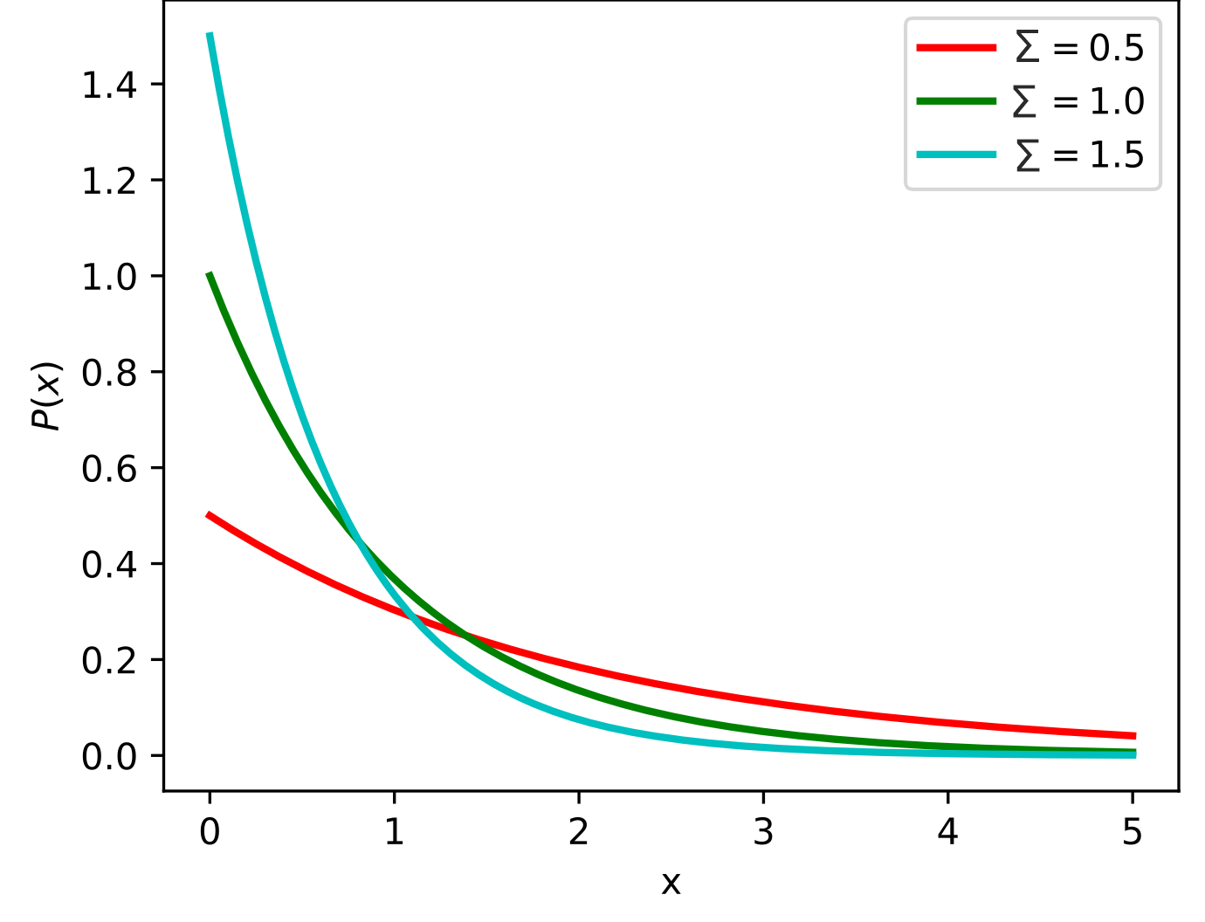
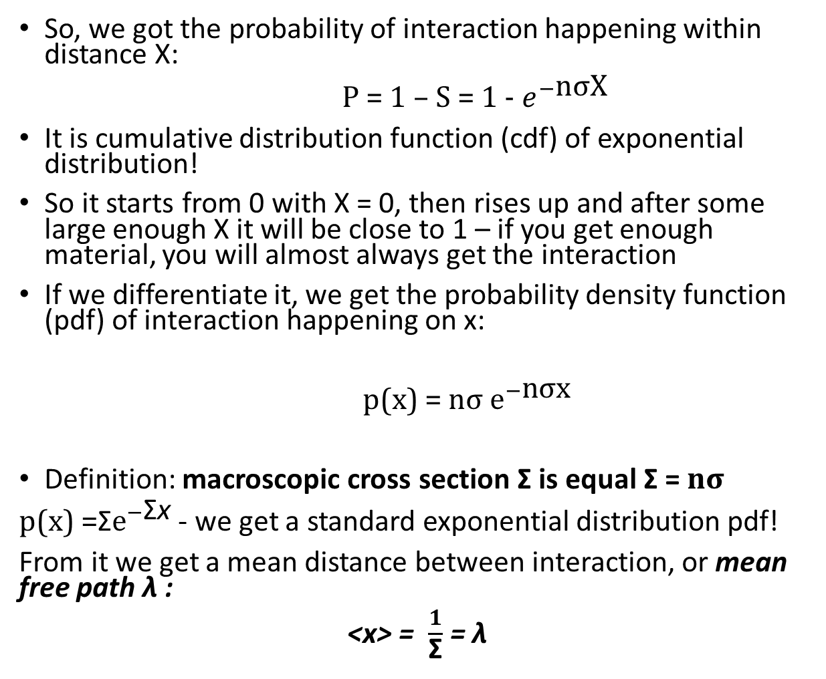
Mean free path
So, we got the probability of interaction happening within distance X:
P = 1 – S = 1 - $e^{−\text{n}\text{σ}\text{X}}$
It is cumulative distribution function (cdf) of exponential distribution!
So it starts from 0 with X = 0, then rises up and after some large enough X it will be close to 1 – if you get enough material, you will almost always get the interaction
If we differentiate it, we get the probability density function (pdf) of interaction happening on x:
p(x) = $\text{n}\text{σ}$ $e^{−\text{n}\text{σ}\text{x}}$
Definition: macroscopic cross section Σ is equal Σ = $\text{n}\text{σ}$
p(x) =Σ$e^{−\text{Σ}\text{x}}$ - we get a standard exponential distribution pdf!
From it we get a mean distance between interaction, or mean free path λ :
<x> = $\frac{1}{\text{Σ}}$ = λ
Cumulative distribution function
Probability density function

Slide 7
Monte Carlo modeling
So, we know how the interaction lengths are distributed!
How to generate samples from this distribution though?
Inverse transform sampling:
You have the cdf F(x) of your desired distribution
You have the ability to generate η from uniform distribution from 0 to 1
You set η = F(x) and solve for x = F⁻¹(η)
You generate η, put it into F⁻¹ and get x. This x will be distributed with cdf F(x)!
It’s a general recipe which works for any continious cdf!
Why that works – there are good intuitive explanations and rigorous proofs in the internet, we will not spend time

Slide 8
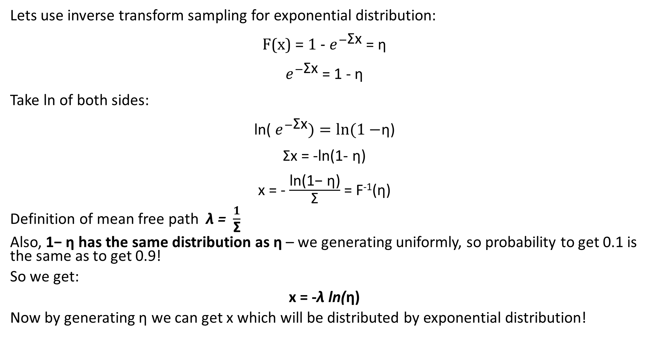
Monte Carlo modeling
Lets use inverse transform sampling for exponential distribution:
F(x) = 1 - $e^{−\text{Σ}\text{x}}$ = η
$e^{−\text{Σ}\text{x}}$ = 1 - η
Take ln of both sides:
ln( $e^{−\text{Σ}\text{x}})=\ln{(1−}$η)
$\text{Σ}\text{x}$ = -ln(1- η)
x = - $\frac{\text{ln}\text{(1− }\text{η}\text{)}}{\text{Σ}}$ = F⁻¹($\text{η}$)
Definition of mean free path λ = $\frac{1}{\text{Σ}}$
Also, $\text{1− }\text{η}$ has the same distribution as $\text{η}$ – we generating uniformly, so probability to get 0.1 is the same as to get 0.9!
So we get:
x = -λ ln($\text{η}$)
Now by generating $\text{η}$ we can get x which will be distributed by exponential distribution!

Slide 9
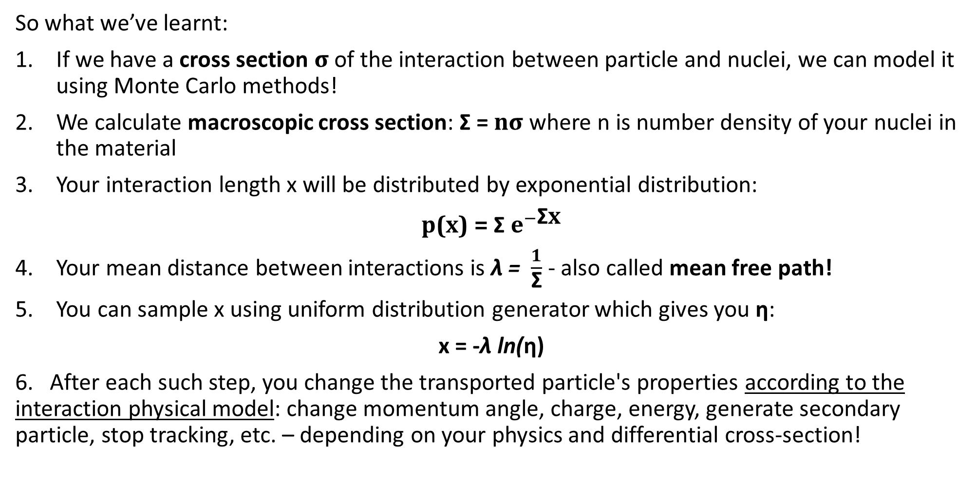
Summarize
So what we’ve learnt:
If we have a cross section $\text{σ}$ of the interaction between particle and nuclei, we can model it using Monte Carlo methods!
We calculate macroscopic cross section: Σ = $\text{n}\text{σ}$ where n is number density of your nuclei in the material
Your interaction length x will be distributed by exponential distribution:
p(x) = Σ $e^{−\text{Σ}\text{x}}$
Your mean distance between interactions is λ = $\frac{1}{\text{Σ}}$ - also called mean free path!
You can sample x using uniform distribution generator which gives you $\text{η}$:
x = -λ ln($\text{η}$)
6. After each such step, you change the transported particle's properties according to the interaction physical model: change momentum angle, charge, energy, generate secondary particle, stop tracking, etc. – depending on your physics and differential cross-section!

Slide 10
How Geant4 transports particles
We studied a simple example with one interaction and one material
Let's now consider an example with several interactions and several materials, and see how Geant4 handles them!
Tracking described in details here https://geant4.web.cern.ch/documentation/dev/bfad_html/ForApplicationDevelopers/TrackingAndPhysics/tracking.html
There are several different types of processes, main are: Discrete, Continuous, AtRest
Discrete processes act at the end of a step. Their interaction length is usually generated from the interaction probability and cross section as we discussed.
Сontinuous processes happen along each step – energy loss, for example. They can give their own step size from some algorithm, e.g. the fraction of total range of the particle
AtRest processes happen after particle has stopped and they propose steps in time! Typical examples – decay, capture, annihilation, adsorption. We will talk about decay in next lecture!
There are also processes which are mixes of these 3 – for example, they both can act along step and post step!

Slide 11
Several processes
Let’s say we have 3 discrete processes d₁, d₂, d₃ each with cross sections
σ₁(E), σ₂(E), σ₃(E) . Let’s assume cross sections depend on energy of the particle.
Let also say we have a continuous process c which have a step size limit of l₁.
At the start of the tracking, Geant4 samples a number of mean free paths n_{λ1}, n_{λ2}, n_{λ3} for each process as -ln(η_{i}), η_{i} ~ Uniform(0,1). Separate η for each!
From these, the step length of each process is calculated:
s₁ = n_{λ1}*λ₁
s₂ = n_{λ2}*λ₂
s₃ = n_{λ3}*λ₃
The smallest proposed step is taken from all processes: min(s₁, s₂, s₃, l₁)!

Slide 12
Several processes
For example, let say in our case s₂ was the smallest.
The continuous process c acts along the step and changes energy, for example.
The discrete process d₂ happens at the end of the step and does its interaction: changes particle energy, momentum, generates secondaries, etc.
For all other discrete processes, the remaining number of mean free paths is recalculated:
n_{λ1rem} = (s₁-s₂)/λ₁
n_{λ3rem} = (s₃-s₂)/λ₃
For process d₂ a new n_{λ2} is generated!
Then, the next step is happening:
For s₁ and s₃ no new value is generated - n_{λ1rem} and n_{λ3rem} are used!
For s₂ - a new n_{λ2} is sampled as -ln(η).
The new s₁, s₂ and s₃ are calculated using new λ - because particle energy may have changed!
For l₁ - its recalculated fully from new particle properties.
Again, the smallest step is taken from (s₁, s₂, s₃, l₁) and procedure repeats!
Some process use corrections for cross-section variation along the step – typically energy of the particle changes along the step, cross-section of the process changes together with its mean free path

Slide 13
Geometry handling
At each step Geant4 updates “Safety” - isotropic distance (sphere radius) to nearest geometry boundary. It is fast to calculate.
If Safety is larger than min(s₁, s₂, s₃, l₁) - normal step happens.
If Safety is smaller - the exact geometric step length g to the next boundary along particle trajectory is calculated and included in step comparison - Safety is always less or equal to g!
Minimum from (s₁, s₂, s₃, l₁, g) is taken!
If g is the smallest proposed step - the particles moves to the boundary and is then “pushed” into the next volume!
The remaining number of n_{λ1}, n_{λ2}, n_{λ3} is recalculated based on taken step length g.
n_{λ1rem} = (s₁-g)/λ₁
n_{λ2rem} = (s₂-g)/λ₂
n_{λ3rem} = (s₃-g)/λ₃
Continuous process c happens along step g.
At the boundary of the new volume, new step lengths are calculated from the remaining n_{λ1rem}​,n_{λ2rem}​, n_{λ3rem} using the new λ values determined by the new cross sections and number densities - the particle may now be in a different material.
l₁ - its recalculated fully from new particle and material properties.

Slide 14
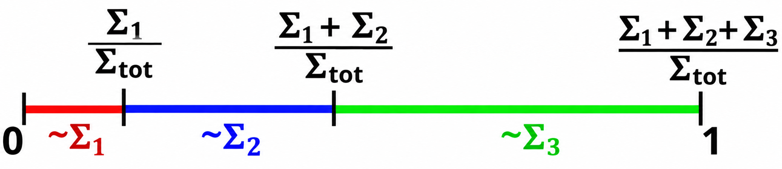
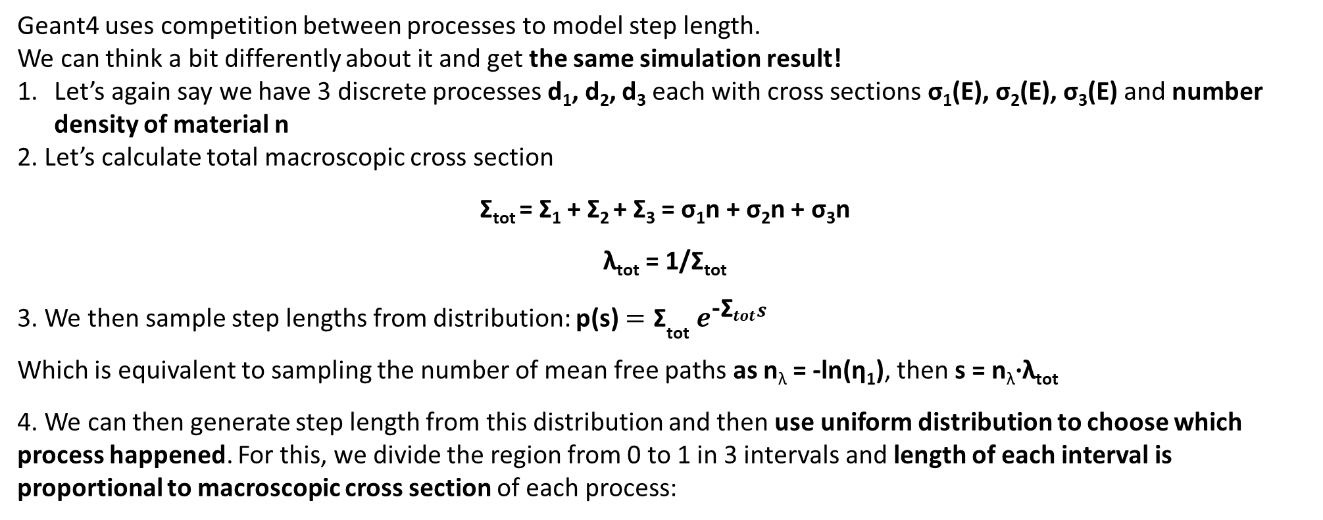
Another way to model discrete processes
Geant4 uses competition between processes to model step length.
We can think a bit differently about it and get the same simulation result!
Let’s again say we have 3 discrete processes d₁, d₂, d₃ each with cross sections σ₁(E), σ₂(E), σ₃(E) and number density of material n
2. Let’s calculate total macroscopic cross section
Σ_{tot} = Σ₁ + Σ₂ + Σ₃ = σ₁n + σ₂n + σ₃n
λ_{tot} = 1/Σ_{tot}
3. We then sample step lengths from distribution: p(s) $={\text{Σ}}_{\text{tot}} e^{{\text{−}\text{Σ}}_{tot}s}$
Which is equivalent to sampling the number of mean free paths as n_{λ} = -ln(η₁), then s = n_{λ}·λ_{tot}
4. We can then generate step length from this distribution and then use uniform distribution to choose which process happened. For this, we divide the region from 0 to 1 in 3 intervals and length of each interval is proportional to macroscopic cross section of each process:
This method can be used to sample from any discrete distribution!
5. Then, we sample a new η₂ and depending on which interval it falls into, the corresponding process happens!
And it can be shown that its equivalent to process competition modeling!

Slide 15
Summarize
So what we’ve learnt:
Geant4 uses competition model to choose step length!
Discrete processes give step as s = λ*n_{λ}, where n_{λ} - number of mean free paths sampled as n_{λ} = -ln(η), η ~ Uniform(0,1)
Continuous processes give some step limits
Geometry - gives distance to closest boundary along the particle trajectory
From all processes and geometry boundaries it chooses the smallest proposed step!
If discrete process proposed the smallest step, it happens!
Continuous processes happen at each step!
For all other discrete processes - remaining number of n_{λ} is recalculated from mean free path and length of taken step
All discrete processes also could be thought of as one general process with cross section equal to sum of all cross sections!
We can sample step length from this total cross section and then choose which process happened depending on its part in total cross section

Slide 16
Example: gamma travels in Ge
So let’s consider a simple example of gamma particle in Ge volume!
In this example we will collect step lengths distribution and how they change depending on your physics list
Also we will see how to get cross sections which are used in the simulation – physics tables are calculated before the event loop
Two additions to RunAction.cc:
#define CALCULATE_MFP
#define PRINT_TABLES
These flags enable or disable parts of the code in the BeginOfRunAction function!
#define PRINT_TABLES - enables print out of cross-sections and mean free paths for phot, compt and conv processes in energy range of 100 eV - 10 MeV
#define CALCULATE_MFP - calculates final mean free path from all processes for some defined energy - we will use it to compare with simulated result!

Slide 17
Source and geometry
Geometry setup: isotropic gamma source in the center of large Ge box!
Two sources to choose from - ¹³⁷Cs and ⁶⁰Co - can choose both if you’d like!
In ⁶⁰Co example you can see how to generate 2 primary particles per event with different properties for each - this corresponds to simplified behavior of typical ⁶⁰Co source
Both placed at (0,0,0)
Geometry - 1000 m³ of Ge in the center!
Large volume - all first steps will be inside!
Material is simple, so we use NistManager

Slide 18
PhysicsList
We create simple physics list for gamma, electron and positrons
1 process is included for gamma - Compton scattering - 2 others are commented for now
3 processes for electrons - multiple scattering, ionization, bremsstrahlung (тормозное излучение)
4 processes for positrons – multiple scattering, ionization, bremsstrahlung, annihilation
Some settings are introduced: minimal energy for table construction, for tracking, some parameters of ionization model - see lines ~ 24-56 in PhysicsList.cc
Small cuts are set - we want to get precise energy spectra, so we want to properly account for secondaries escaping the volume

Slide 19
SteppingAction
We want to see that step length distribution agrees with exponential distribution
If we collect all steps in histogram - it will be a mess of several superimposed exponential distributions from several energies
So we collect only the first step length - at its start the particle has the well-defined energy set in your PrimaryGeneratorAction!
So we check several things in stepping action:
track->GetTrackID() == 1 - this checks if particle is the first primary
track->GetDefinition()->GetParticleName() == "gamma" - checks particle name
step->IsFirstStepInVolume() - checks that step is the first after entering the volume
prevolume_name == "DetectorLV" - checks that step is in proper volume
Then we get the process:
auto proc = step->GetPostStepPoint()->GetProcessDefinedStep();
And check that it exists and its not a geometrical step
proc && proc->GetProcessType() != fTransportation
And then collect the step length in the histogram:
G4double length = step->GetStepLength() / mm;
analysisManager->FillH1(1, length);

Slide 20
RunAction
We create 2 histograms - one for energy spectra, other for step length
auto analysisManager = G4AnalysisManager::Instance();
analysisManager->CreateH1("Energy_spectra","Deposited energy spectrum",10000,0,2700);
analysisManager->CreateH1("Step_length", "Step length", 3000, 0., 600);
In EndOfRunAction we get the mean of the step length histogram from master thread and print it - we use it to compare with cross section calculated mean free path in BeginOfRunAction function
if(isMaster) std::cout << "Mean first step from simulation: " << analysisManager- >GetH1(1)->mean() << std::endl;
We can also get bin content, number of entries, standard deviation, maximum, etc. - see the commented code

Slide 21
Results
So, we have only Compton scattering
Energy of gamma is 661.7 keV
From tables we get:
526.646 keV lambda(mm): phot=1.79769e+308 compt=25.0202 conv=1.79769e+308
631.975 keV lambda(mm): phot=1.79769e+308 compt=26.974 conv=1.79769e+308
758.37 keV lambda(mm): phot=1.79769e+308 compt=29.2159 conv=1.79769e+308
910.044 keV lambda(mm): phot=1.79769e+308 compt=31.792 conv=1.79769e+308
Impossibly large mean free paths for photoelectric process and pair creation process - we didn't enable them, so calculator outputs DBL_MAX – maximal value of double type variable!
For Compton mean free path slowly changes with energy
If we ask to calculate exact value for 661.7 keV - its 27.5103 mm

Slide 22
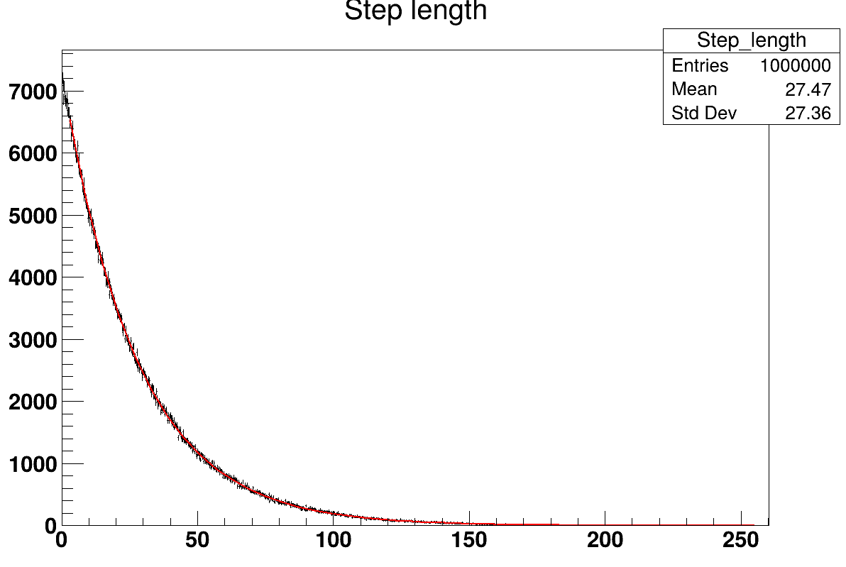
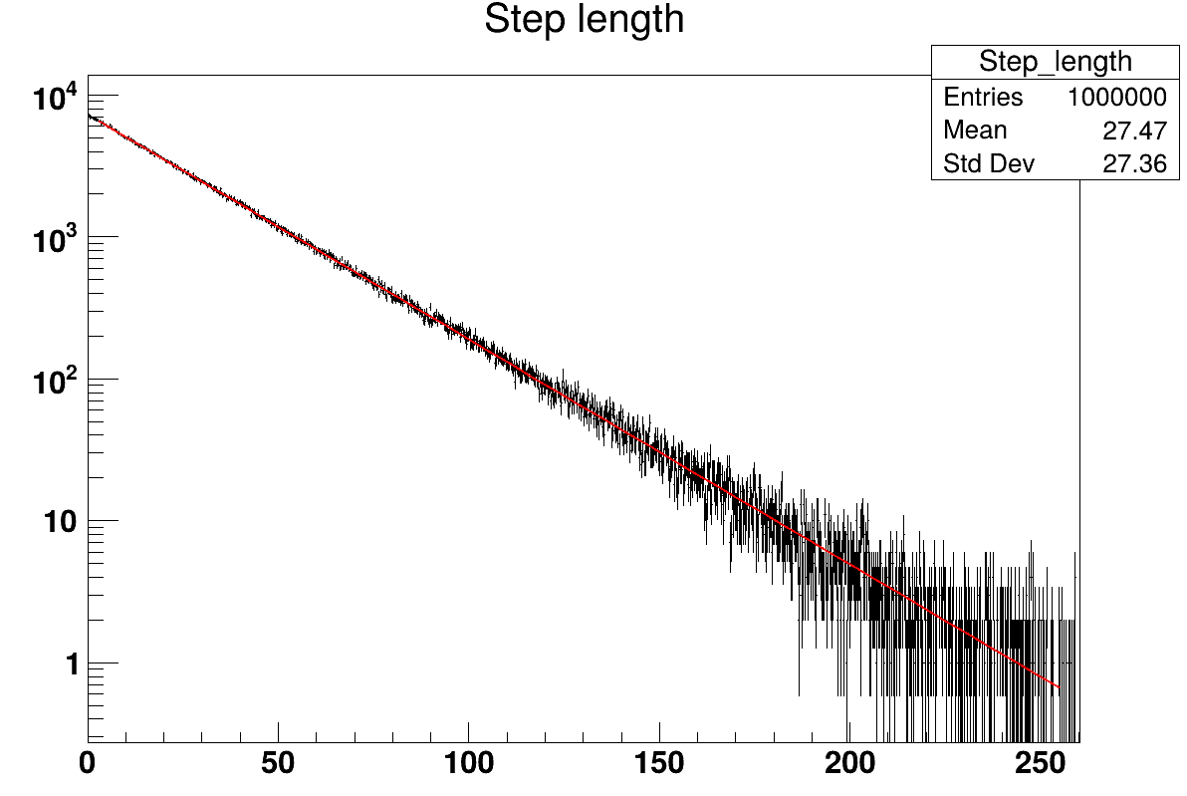
Results
Energy spectrum – one peak at 661.7 keV!
Compton continuum is a geometry effect – it exists because scattered gammas escape before depositing everything
Shape and edge of spectrum will be determined by physics – see homework
Calculated mean free path from cross section for ¹³⁷Cs gamma - 27.51 mm
Mean first step length in simulation - 27.4986 mm!
Distribution form is also exponential - you can use Fit Panel in TBrowser to check
Also if we make Y-axis logarithmic we will see a straight line
So, step length s is sampled from distribution:
p(s) = Σ e^{-Σ s}
where Σ is macroscopic cross section of your process

Slide 23
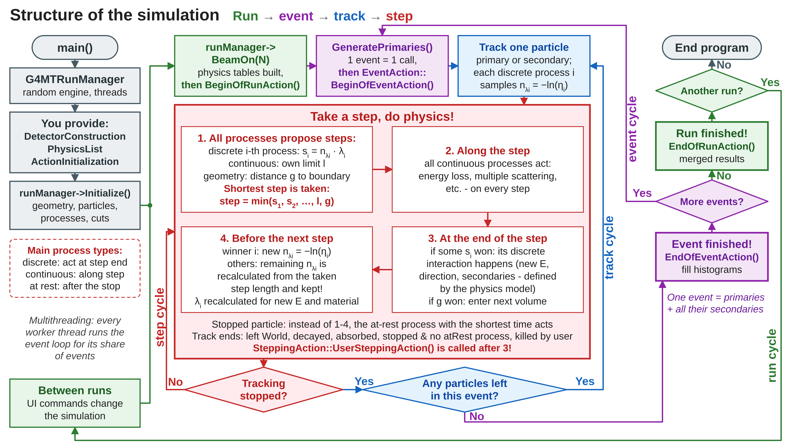

Slide 24
Some homework if you like
Enable other two processes for gamma particles in physics list. Observe the change in calculated tables. Start the simulation and observe the difference in the resulting mean free path. Compare simulated mean first step length and calculated mean free path.
Change starting energy of gamma particle to 2 MeV. Change the energy used to 2 MeV in CALCULATE_MFP section in BeginOfRunAction. See the difference between calculated mean free path and simulated mean step length.
Change geometry to a more realistic one:
Make germanium volume a box with side length of 8 cm
Move source outside of Germanium volume to the distance of 1 cm from the detector plane. Use #DRAW to see if geometry is correct. Observe the change in energy spectrum.
Change source to ⁶⁰Co. Observe the difference in energy spectra.
Add 4 cm thick lead shielding volumes around the box from all sides except the source side. Observe difference in energy spectra.

